Slide 1

Digging into the DEA Opiate Database
Project 1
Team 1:Wyatt Carnes, Keven McClard, John Soltis
July 30th, 2019

Slide 2

Hypothesis
Counties with lower incomes and counties whose residents work construction jobs will typically correlate with higher opiate distribution rates.

Slide 3

Data Sources
DEA database published by the Washington Post
https://www.washingtonpost.com/graphics/2019/investigations/dea-pain-pill-database/?utm_term=.8654ced443f9
“Data analyzed includes only shipments from sales of oxycodone and hydrocodone pills to retail pharmacies, chain pharmacies and practitioners. The entire database tracks a dozen different opioids, including oxycodone and hydrocodone, which make up three-quarters of the total pill shipments to pharmacies.”
80GB of raw data including:
Manufacturer
Distributor
Type of Pill
Quantity of Pills
Dosage
United States Census API Data
https://www.census.gov/developers/
County level:
Population
Median Income
Occupations
Poverty Rates

Slide 4

Parsing and Cleaning Data
*See Jupyter Notebook

Slide 5
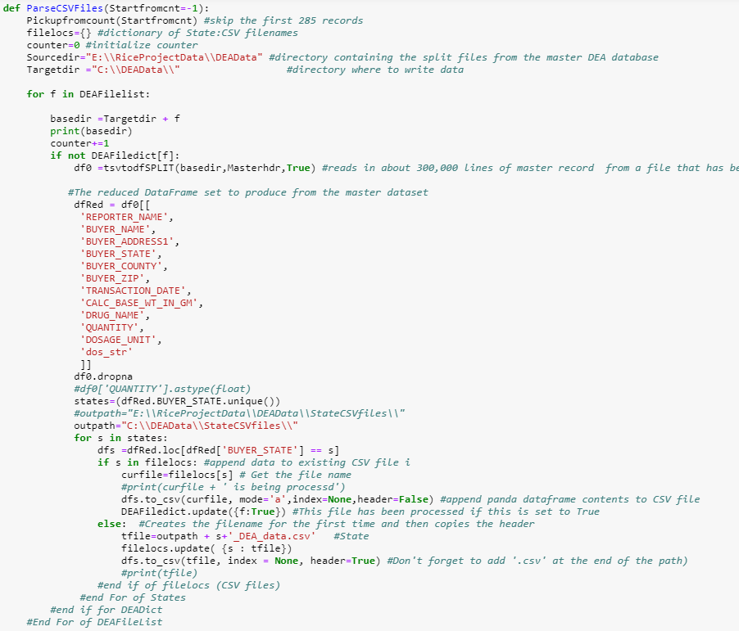
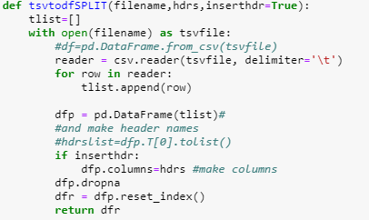
Parsing DEA Data

Slide 6

Manipulating and Merging Data
Modify County names in both DEA and Census data to match
Select and rename columns to be readable in the census dataframe
Merge data on “County” field

Slide 7
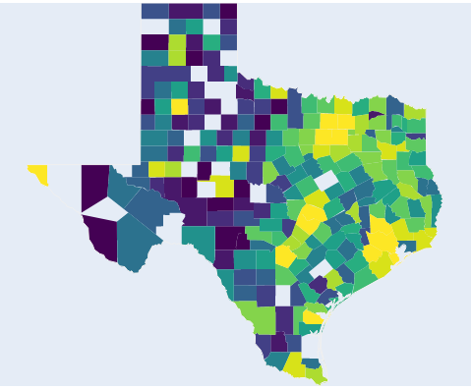
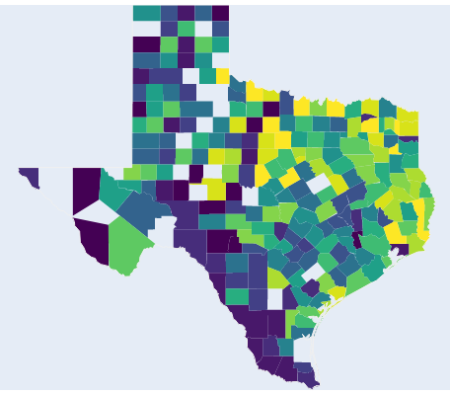
Analysis – total dosage per capita
Total Opiate Dosage Ordered
Per Capita Opiate Dosage Ordered
As expected, the gross number of pills distributed is highest in urban areas but once the population is taken into account, the per capita concentrations tend to increase in the surrounding counties.

Slide 8
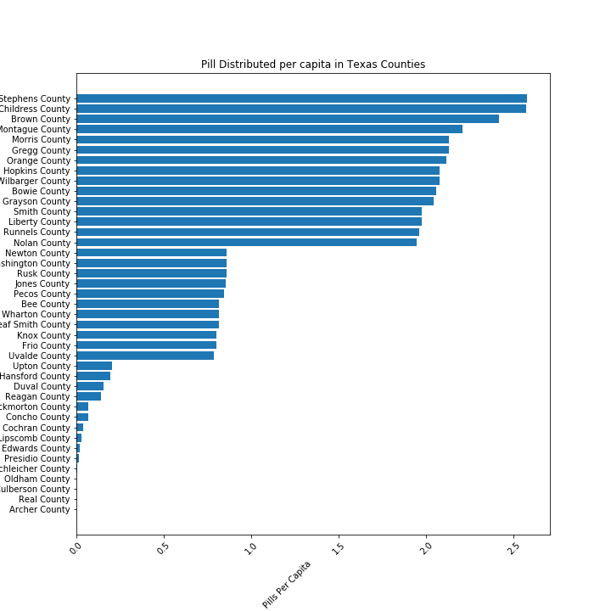
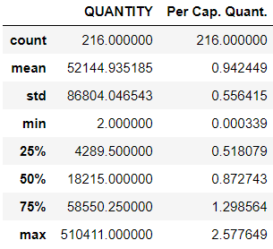
Analysis

Slide 9
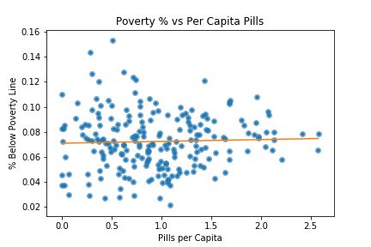
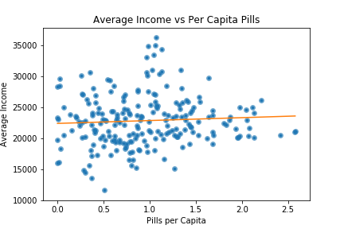
Analysis
No material correlations

Slide 10
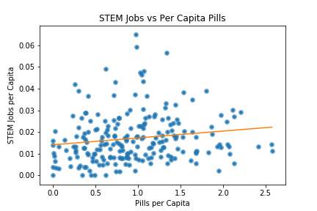
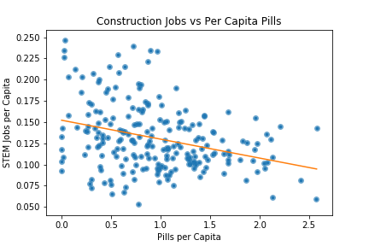
Analysis
STEM Jobs vs Pill Quantity
Construction Jobs vs. Pill Quantity
STEM jobs have a slight positive correlation while Construction jobs have a more pronounced negative correlation

Slide 11
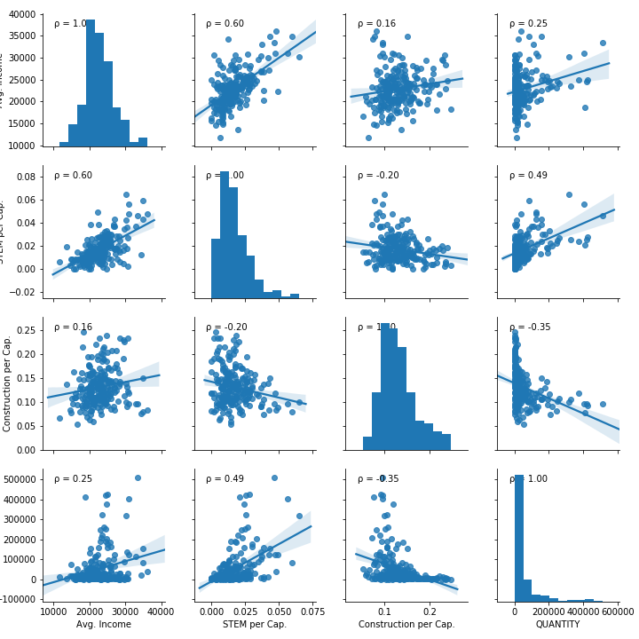
Analysis
There are no overwhelmingly strong correlations observed. The strongest with a 0.6 correlation coefficient is STEM Jobs and Average Income.
Interestingly pill quantity correlates positively with STEM jobs per capita and negatively with Construction jobs per capita.

Slide 12

Challenges
80GB DEA database was too large to handle normally and had to be broken down into multiple smaller files and then parsed into state level files to be useable in Pandas
The DEA database had very poor documentation

Slide 13

Conclusions and Further Work
No clear or statistically significant correlations in the observed census data to opiate distribution
Contrary to our hypothesis, construction jobs have a negative correlation to opiate distribution while STEM jobs have a positive correlation
Next steps would be to evaluate opiate related overdoses and deaths and work to correlate to distribution numbers and population to try and find where opiates are being appropriately prescribed rather than abused.

